Slide 1
Operators

Slide 2
Operators are used to assign values, compare values, perform arithmetic operations, and more.
There are different types of JavaScript operators:
1. Arithmetic Operators
2. Assignment Operators
3. Comparison Operators
4. Logical Operators
5. Bitwise Operators
6. Conditional Operators
7. Type Operators

Slide 3
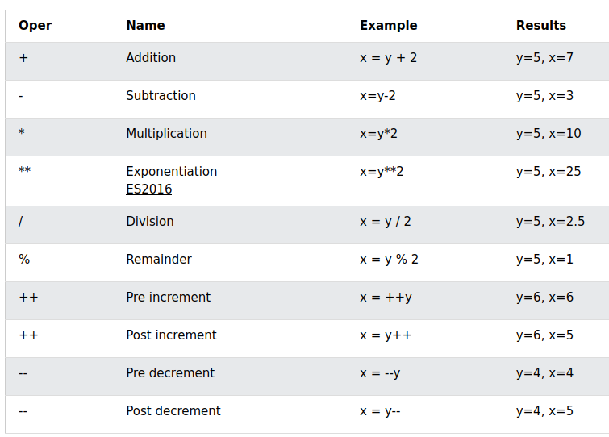

Arithmetic Operators

Slide 4
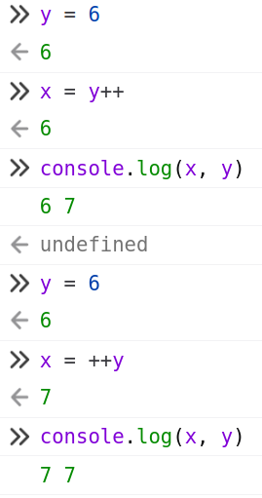
Notes on Arithmetic Operators
Modulo is extensively used when we have to check for odd or even numbers.
What is the difference between post-increment and pre-increment?
Ans:
Pre-increment: first it increments then it assigns.
Post-increment: first it assigns, then it increments.
X = y++
X= ++y
Value of y will be incremented in both the cases.
The change is in the assignment.

Slide 5
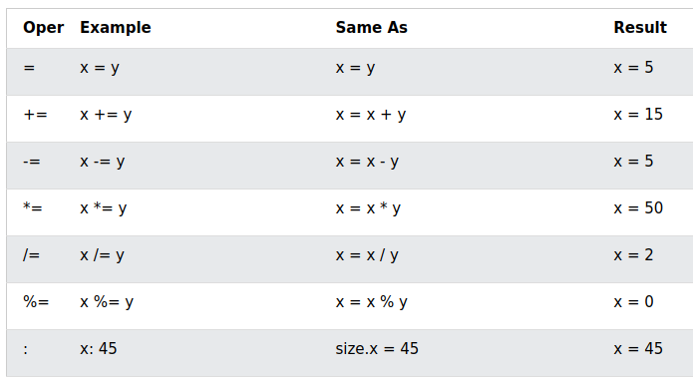
Assignment Operators
Given that x = 10 and y = 5, the table below explains the assignment operators:

Slide 6
Assigment to a property of a JSON object
/* Assigning to a string variable */
let name = "Ashish";
/* Assigning to a numeric variable */
let age = 7
/* Assigning to a property of a JSON object at the time of definition */
let person = {
"name": "Alpha",
"nationality": "Indian"
};
/* Assigning to a property of a JSON object through dot operator */
person.name = "Beta";

Slide 7
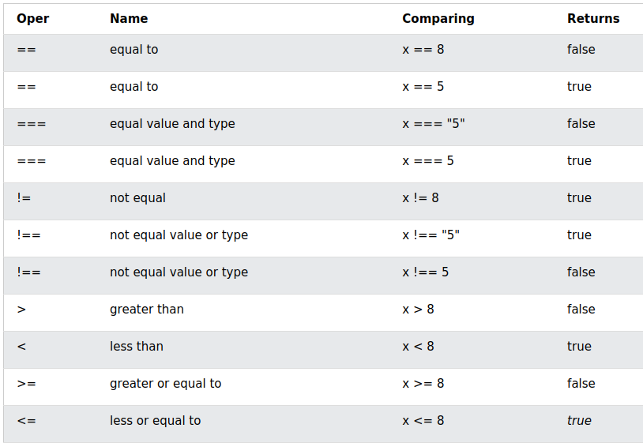
Comparison Operators
Given that x = 5, the table below explains the comparison operators:

Slide 8
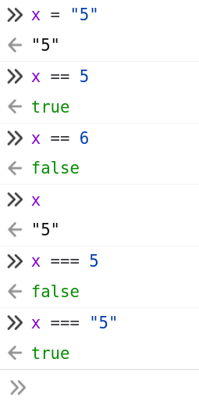
Notes on Comparison Operators

Slide 9
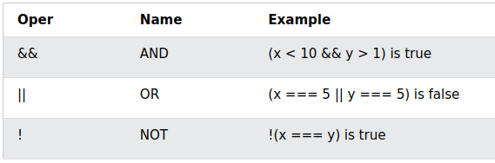
Logical Operators
Given that x = 6 and y = 3, the table below explains the logical operators:

Slide 10
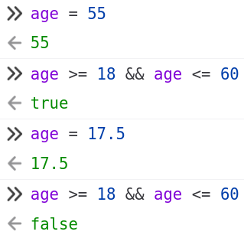
Check if a person is eligible work or not?
Age is that factor. If age is < 18, then the person is too young.
If age > 60, then the person is too old.

Slide 11
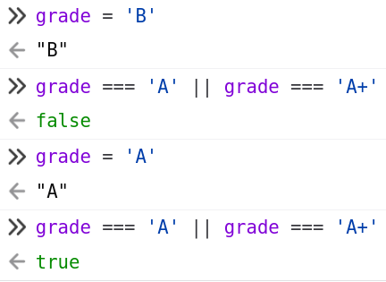
Check eligibility for a scholarship
If the grade of a person is ‘A’ or ‘A+’, the person is eligible for a scholarship.

Slide 12
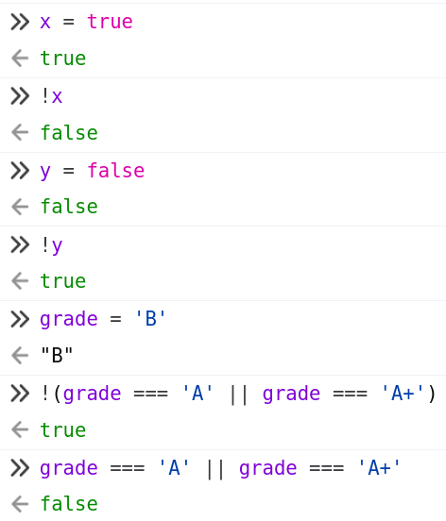
Check non-eligibility for scholarship
If I just say “grade not equal to A or A+”.
Or this is good “grade == B or grade == C or grade == D or grade == E or grade == F or grade == ‘B+’ ...” This will be very complex.
Eligibility condition is: grade === 'A' || grade === 'A+'
Non eligibility condition is:

Slide 13
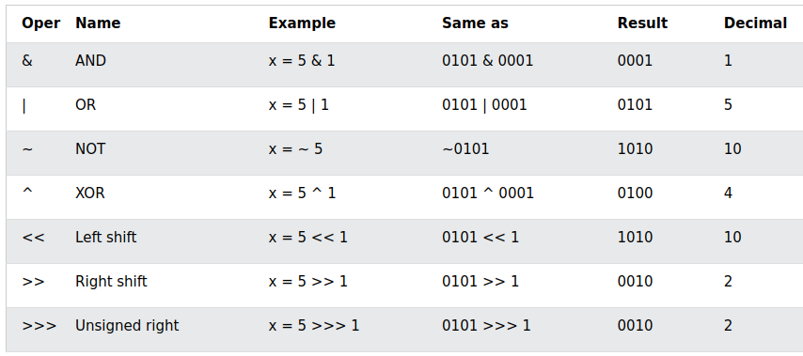
Bitwise Operators
Bit operators work on 32 bits numbers. Any numeric operand in the operation is converted into a 32 bit number. The result is converted back to a JavaScript number.
The table above uses 4 bits unsigned number. Since JavaScript uses 32-bit signed numbers, ~ 5 will not return 10. It will return -6.
~00000000000000000000000000000101 (~5)
will return
11111111111111111111111111111010 (-6)

Slide 14
Truth Tables For AND (&), OR (|) and XOR (^)
x | y | &
0 | 0 | 0
0 | 1 | 0
1 | 0 | 0
1 | 1 | 1
x | y | |
0 | 0 | 0
0 | 1 | 1
1 | 0 | 1
1 | 1 | 1
x | y | ^
0 | 0 | 0
0 | 1 | 1
1 | 0 | 1
1 | 1 | 0

Slide 15
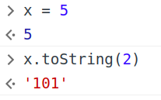
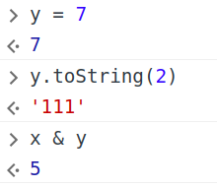
Bitwise AND
x | 1 | 0 | 1
y | 1 | 1 | 1
x & y | 1 | 0 | 1

Slide 16
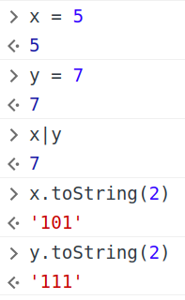
Bitwise OR
x | 1 | 0 | 1
y | 1 | 1 | 1
x | y | 1 | 1 | 1

Slide 17
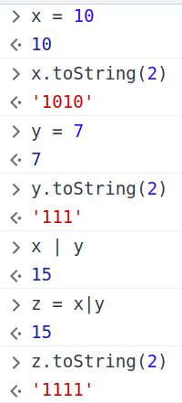
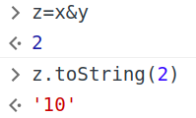
Another example of Bitwise AND and OR
x | 1 | 0 | 1 | 0
y |  | 1 | 1 | 1
| | 1 | 1 | 1 | 1
x | 1 | 0 | 1 | 0
y |  | 1 | 1 | 1
& | 0 | 0 | 1 | 0

